Slide 1
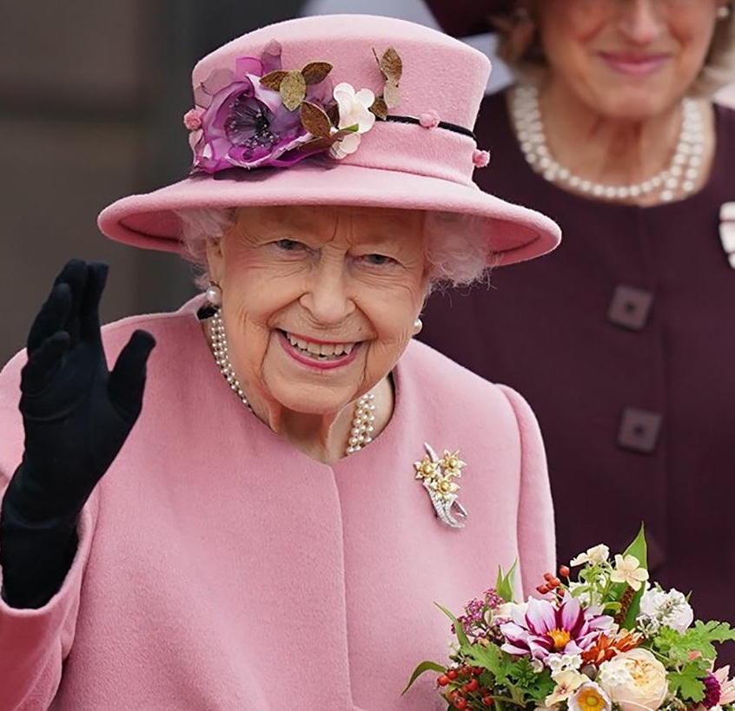
Change this image
Commonwealth of Kindness
Creative Brief
Draft brief by Heather MacRae 21 February 2022 (v8)

Slide 2
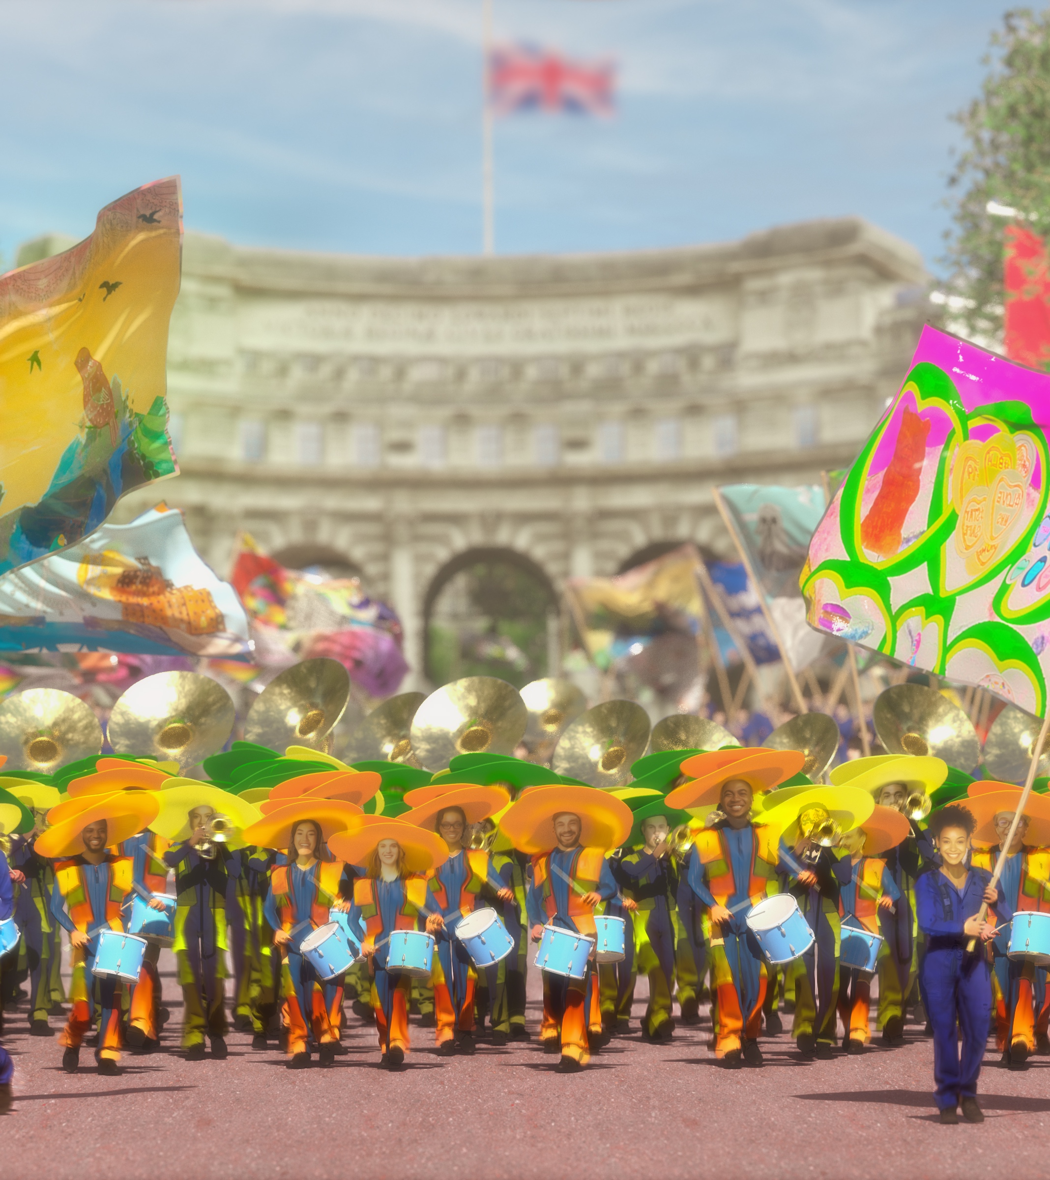
Introduction
Celebrations will be taking place during the year but with a focus on the long weekend and the Platinum Jubilee Pageant taking place on Sunday 5 June. It is an opportunity to embrace your community.
Ideas Foundation is unleashing the creativity of young people to create digital stories that celebrate The Queen’s values of diversity, sustainability and kindness through creative work that will displayed across the UK.
Find out more at www.platinumpageant.com
https://twitter.com/Jubilee_Pageant/status/1430074926556491776?s=20&t=uPgMpHna_C5uTKbFcJUD_w
2 | Ideas Foundation brief

Slide 3
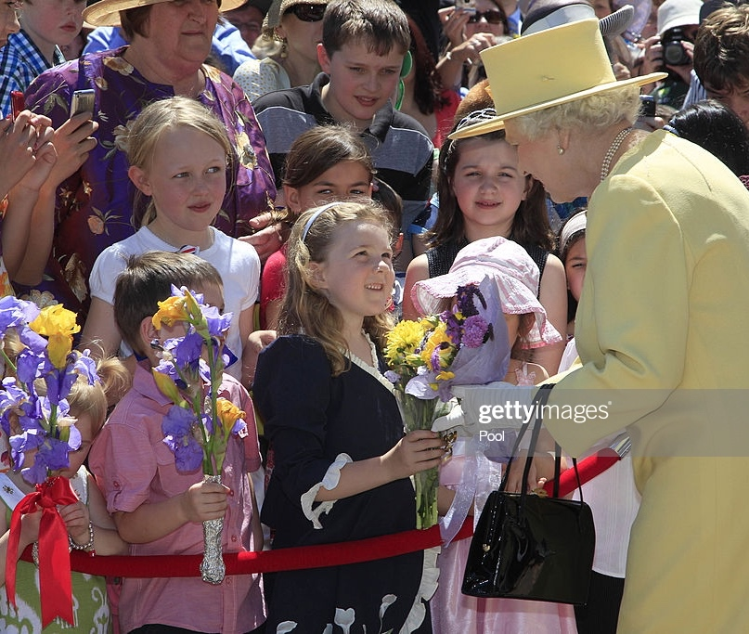
Her Majesty The Queen
Leading with kindness
Even before she was Queen, Princess Elizabeth promised her ‘whole life’ to public service. She has filled the 70 years of her reign with kindness.
Her Majesty is not just The Queen of the United Kingdom, she is Head of the 54 countries of the Commonwealth of nations. The Queen has led the way to establish a new relationship with countries that were part of Britain’s original Empire using kindness every step of the way.
In her 2021 Christmas Speech The Queen said her Jubilee would be “an opportunity for people everywhere to enjoy a sense of togetherness”.
3 | Ideas Foundation brief

Slide 4
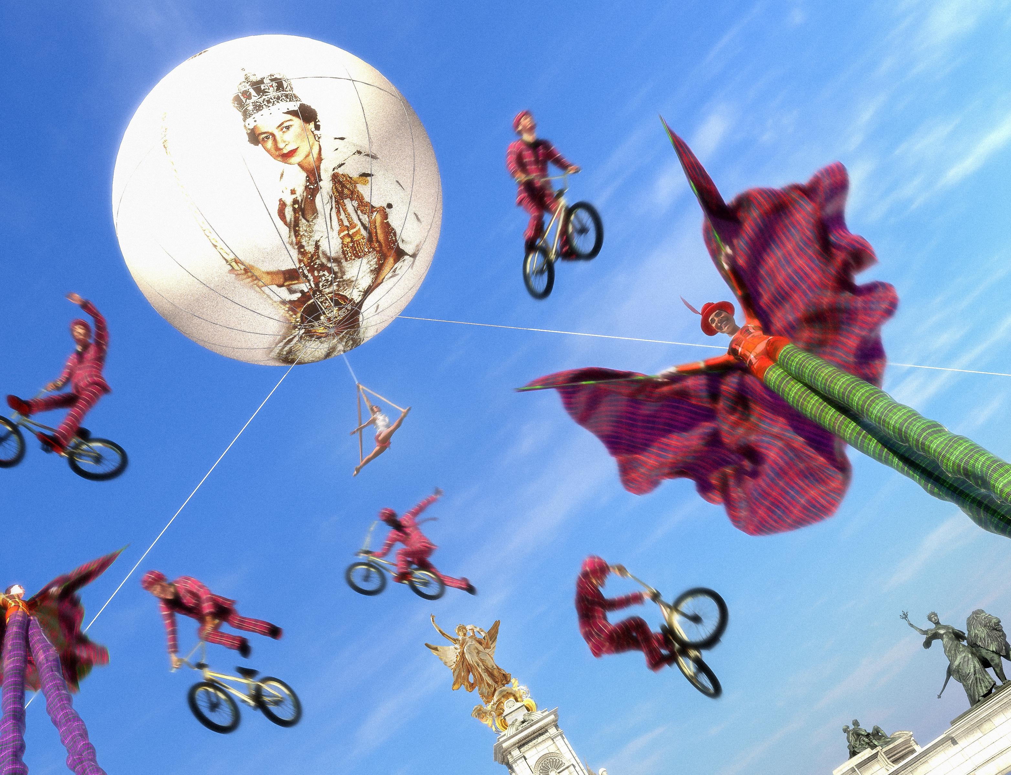
About the Platinum Jubilee Pageant Messaging
The Platinum Jubilee Pageant is a celebration of all our communities and is a once in a lifetime event, that will rediscover the spirit of kindness that was so strong around the time of the London Olympics in 2012 and we hope will encourage people to come together and celebrate.
The event marks the reawakening of the creative sector, drawing on talent from every corner of the UK and Commonwealth.
The Platinum Jubilee Pageant will be both socially and environmentally conscious, engaging diverse communities, people, sectors, and volunteers from local enterprises and community groups. It will represent the multi-cultural society that is Britain both in the run-up to and during the celebration.
4 | Ideas Foundation brief

Slide 5
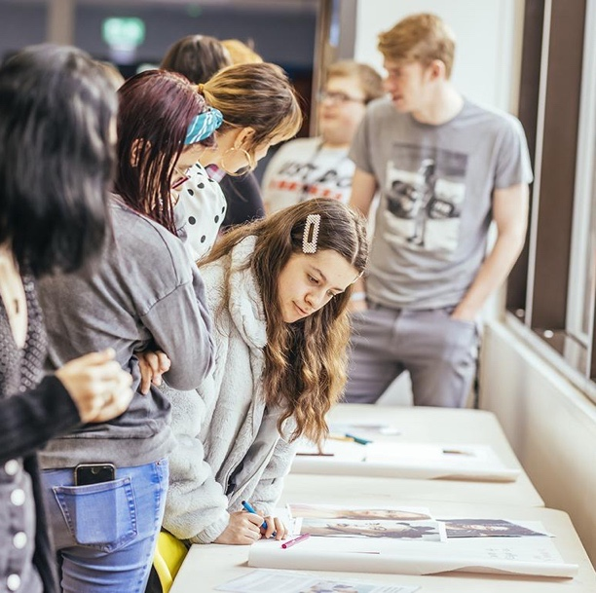
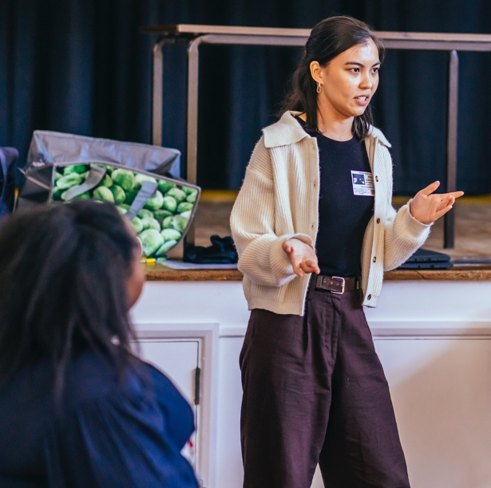
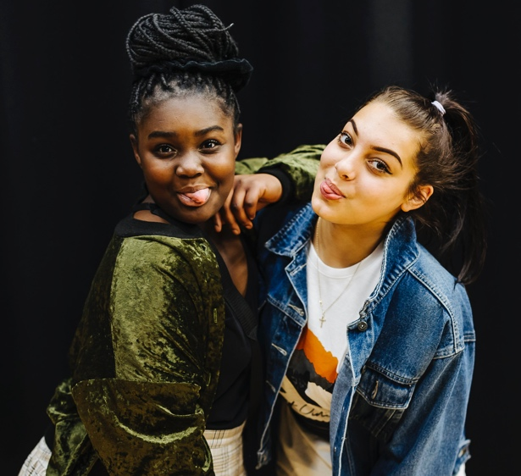
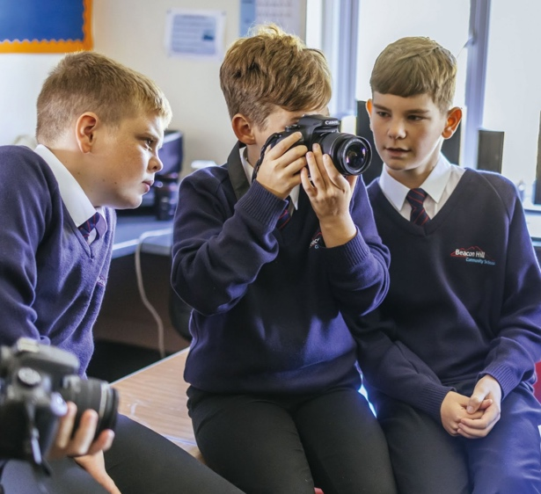
About the Ideas Foundation
What we do
Ideas Foundation is working with the Platinum Jubilee Pageant. We have been providing creative opportunities for students and schools since 2000 working with major brands.
This project aims to bring together young people from communities across the UK to learn skills and create content that celebrates the life and values of Her Majesty The Queen, and recognises the huge social change that has occurred during the 70 years of her reign.
You can find out more about Ideas Foundation on our social channels Twitter, Instagram, TikTok @Ideasfoundation
Photos Tom Martin
5 | Ideas Foundation brief

Slide 6
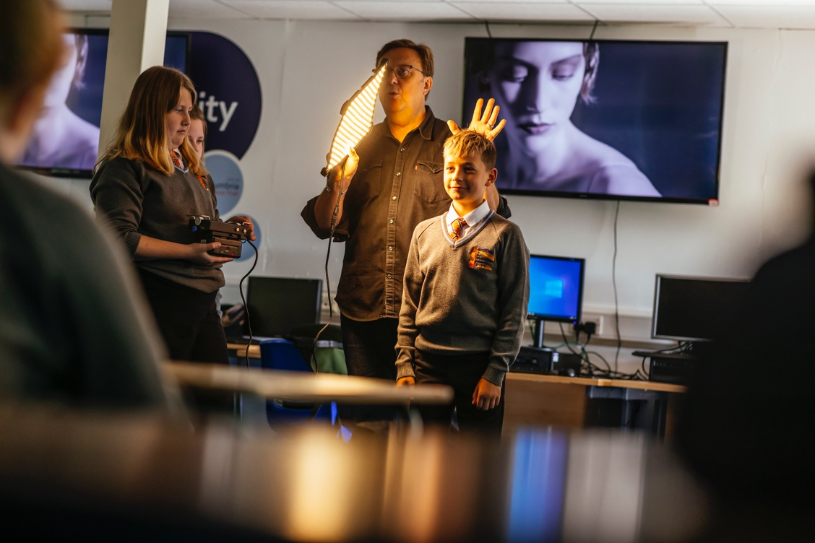
What you will achieve
Objectives
Working with creative professionals to create powerful images that can tell the story of your community.
By the end of the day you will have learnt…
To improve your ability to think creatively.
The importance of community spirit.
To increase social and environmental awareness.
To celebrate empathy and diversity in the community.
To develop skills needed to communicate a message.
To improve your creative skills and use your personal voice.
Photo: Tom Martin
6 | Ideas Foundation brief

Slide 7
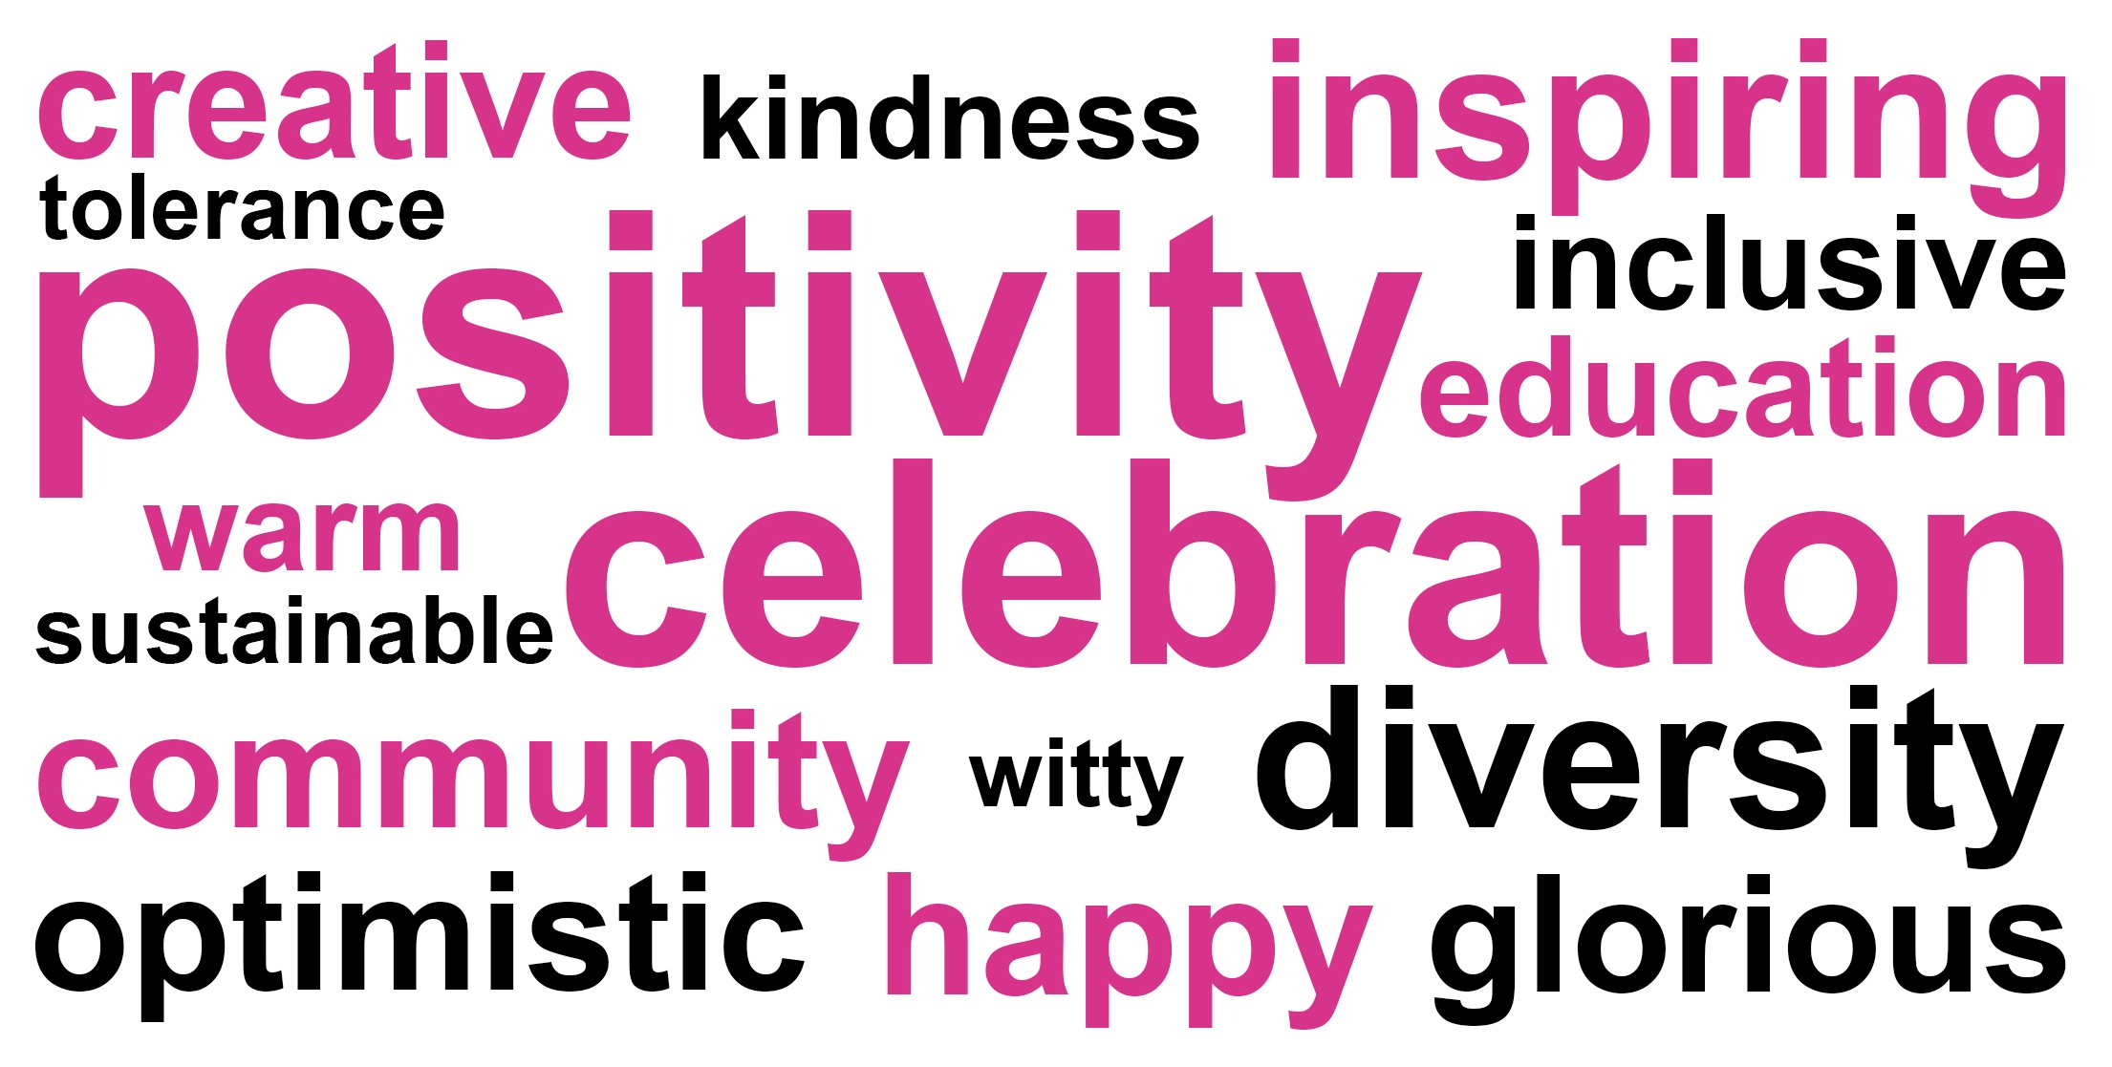
About the campaign
Tone of voice
7 | Ideas Foundation brief

Slide 8
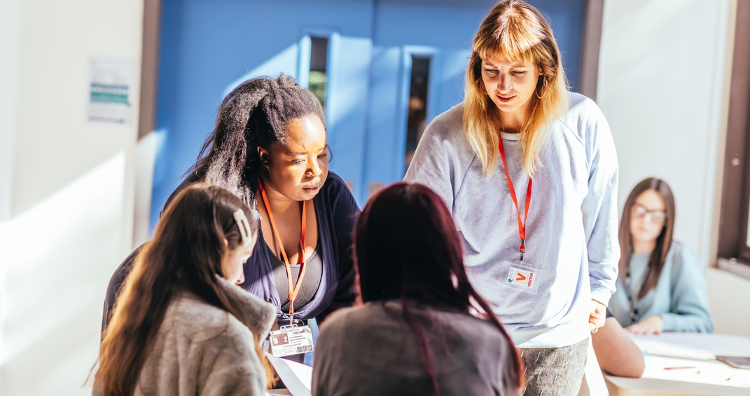
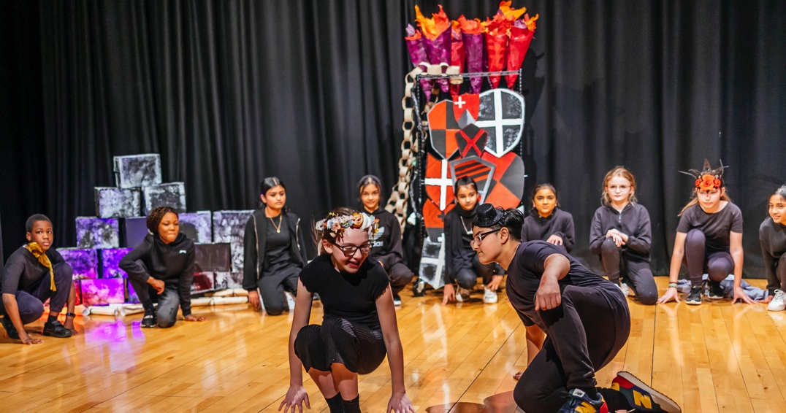
About the campaign
Commonwealth of Kindness
You are being commissioned to create a campaign to celebrate The Queen’s Platinum Jubilee Pageant. Your brief will also align with the United Nation sustainable development goals - sustainable cities and communities. You will be working alongside leading poets, photographers, and creatives.
A selection of students will have the unique opportunity of being selected to attend the Platinum Jubilee Pageant in London on Sunday 5 June 2022.
Your work may be featured in billboards across the country and in press articles locally. Although you may not use images of The Queen, your work should reflect the celebration of The Queen’s Platinum Jubilee Pageant and all that it will stand for.
Photos: Tom Martin
8 | Ideas Foundation brief

Slide 9
United Nations Global Goals
The World’s To Do List
In 2015, world leaders agreed to 17 Global Goals and you may want to consider these within your piece of work:
No Poverty I Zero Hunger I Good Heath & Well-being I Quality Education I Gender Equality I Clean Water & Sanitation I Affordable & Clean Energy I Decent Work & Economic Growth I Industry, Innovation & Infrastructure I Reduced Inequalities I Sustainable Cities & Communities I Responsible Consumption & Production I Climate Action I Life Below Water I Life on Land I Peace Justice & Strong Institutions I Partnerships for the Goals
9 | Ideas Foundation brief

Slide 10
About the campaign
What are the Queen’s values?
Take a moment to consider what you think Her Majesty The Queen’s values are. In your creative work, you may want to show how The Queen’s values compare to your own. Which of these values do you see in the community around you? What does being part of a community mean to you? Think about what kindness and community mean to you and those around you. Consider an individual act of kindness or a group act of kindness and the impact it has had.
Role Model I Service I Kindness I Respect for Indigenous People I
Loyalty I Commonwealth I Resilience I Dedication I Unselfish I Positivity I
Love of Nature I Care of Animals I Hard Working I Hope I Optimism I Duty I
10 | Ideas Foundation brief

Slide 11
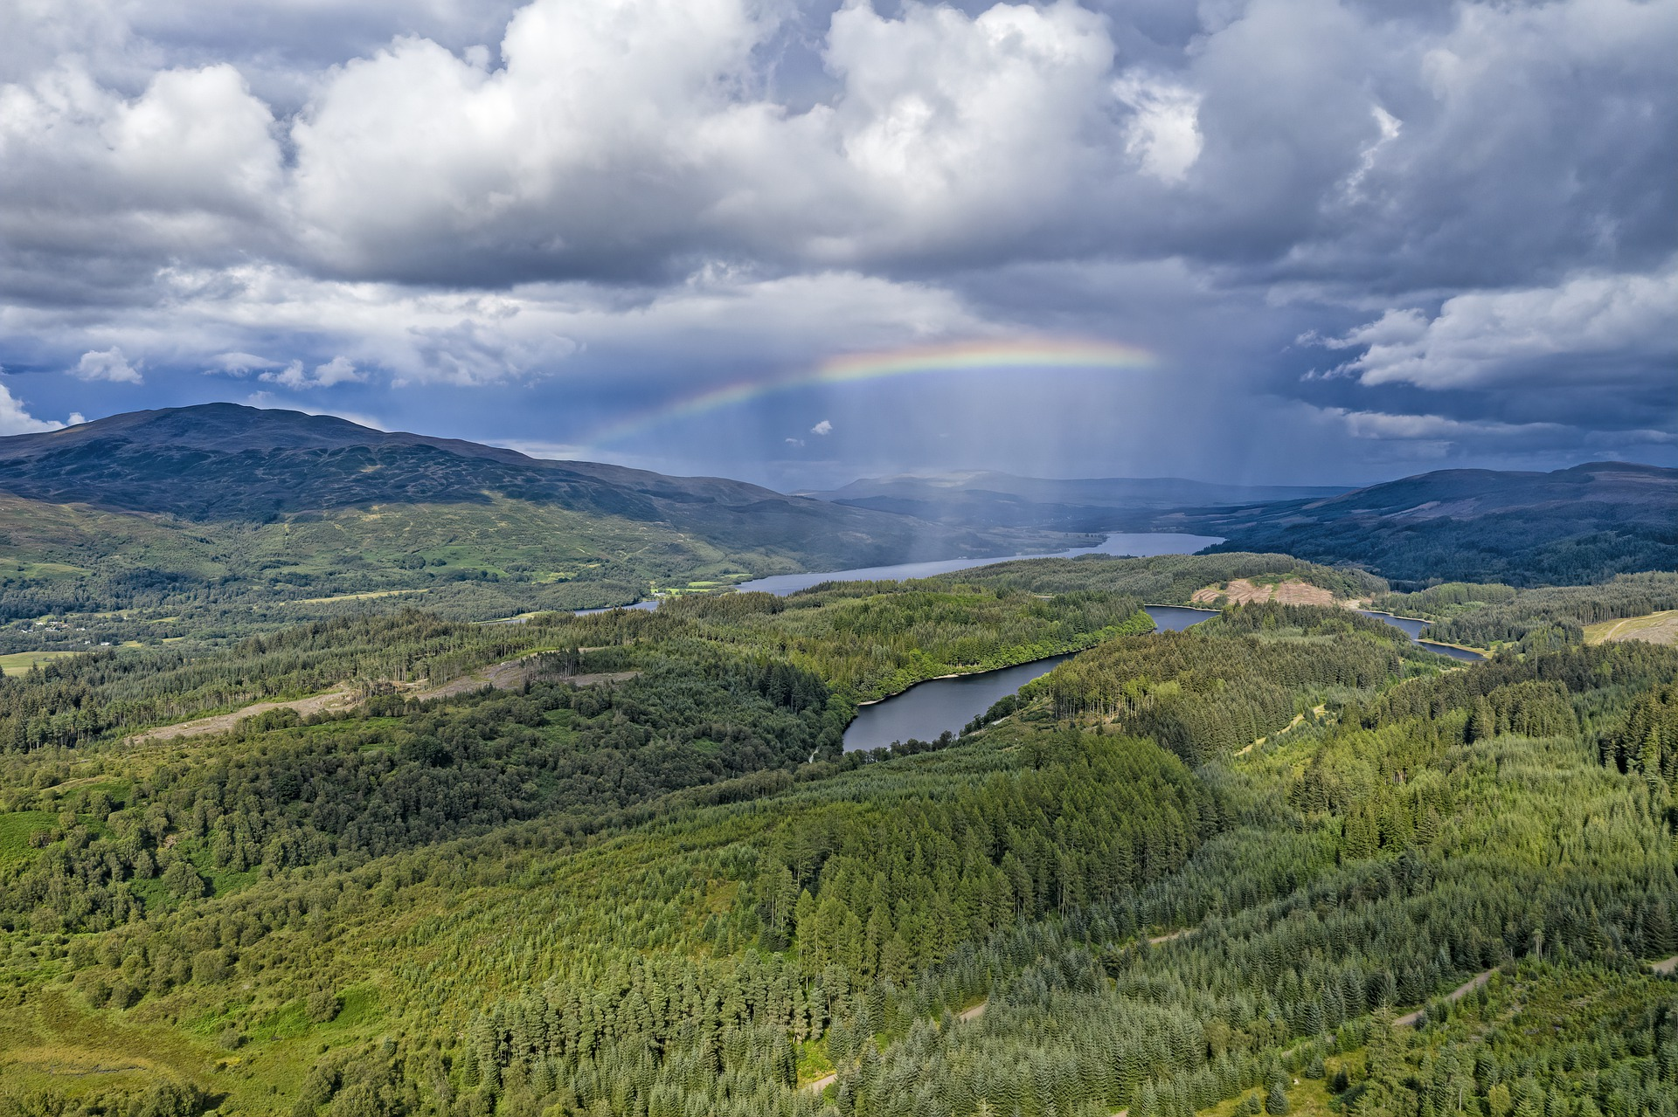
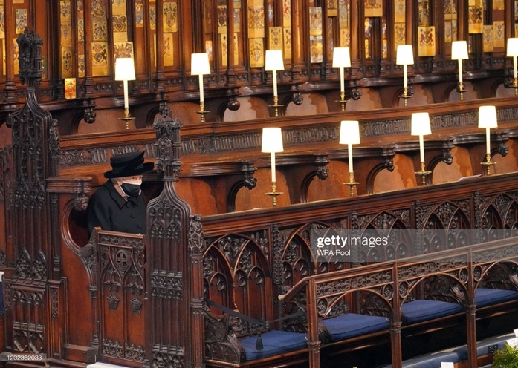
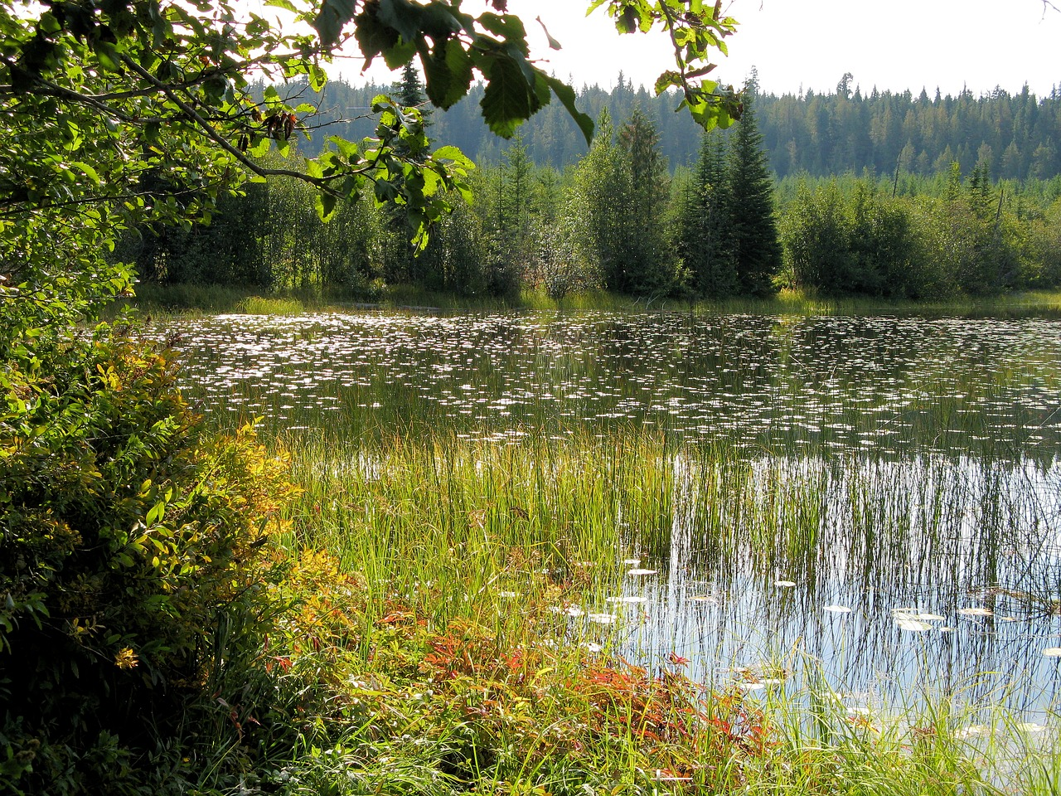
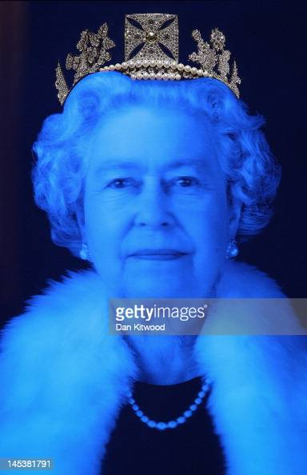
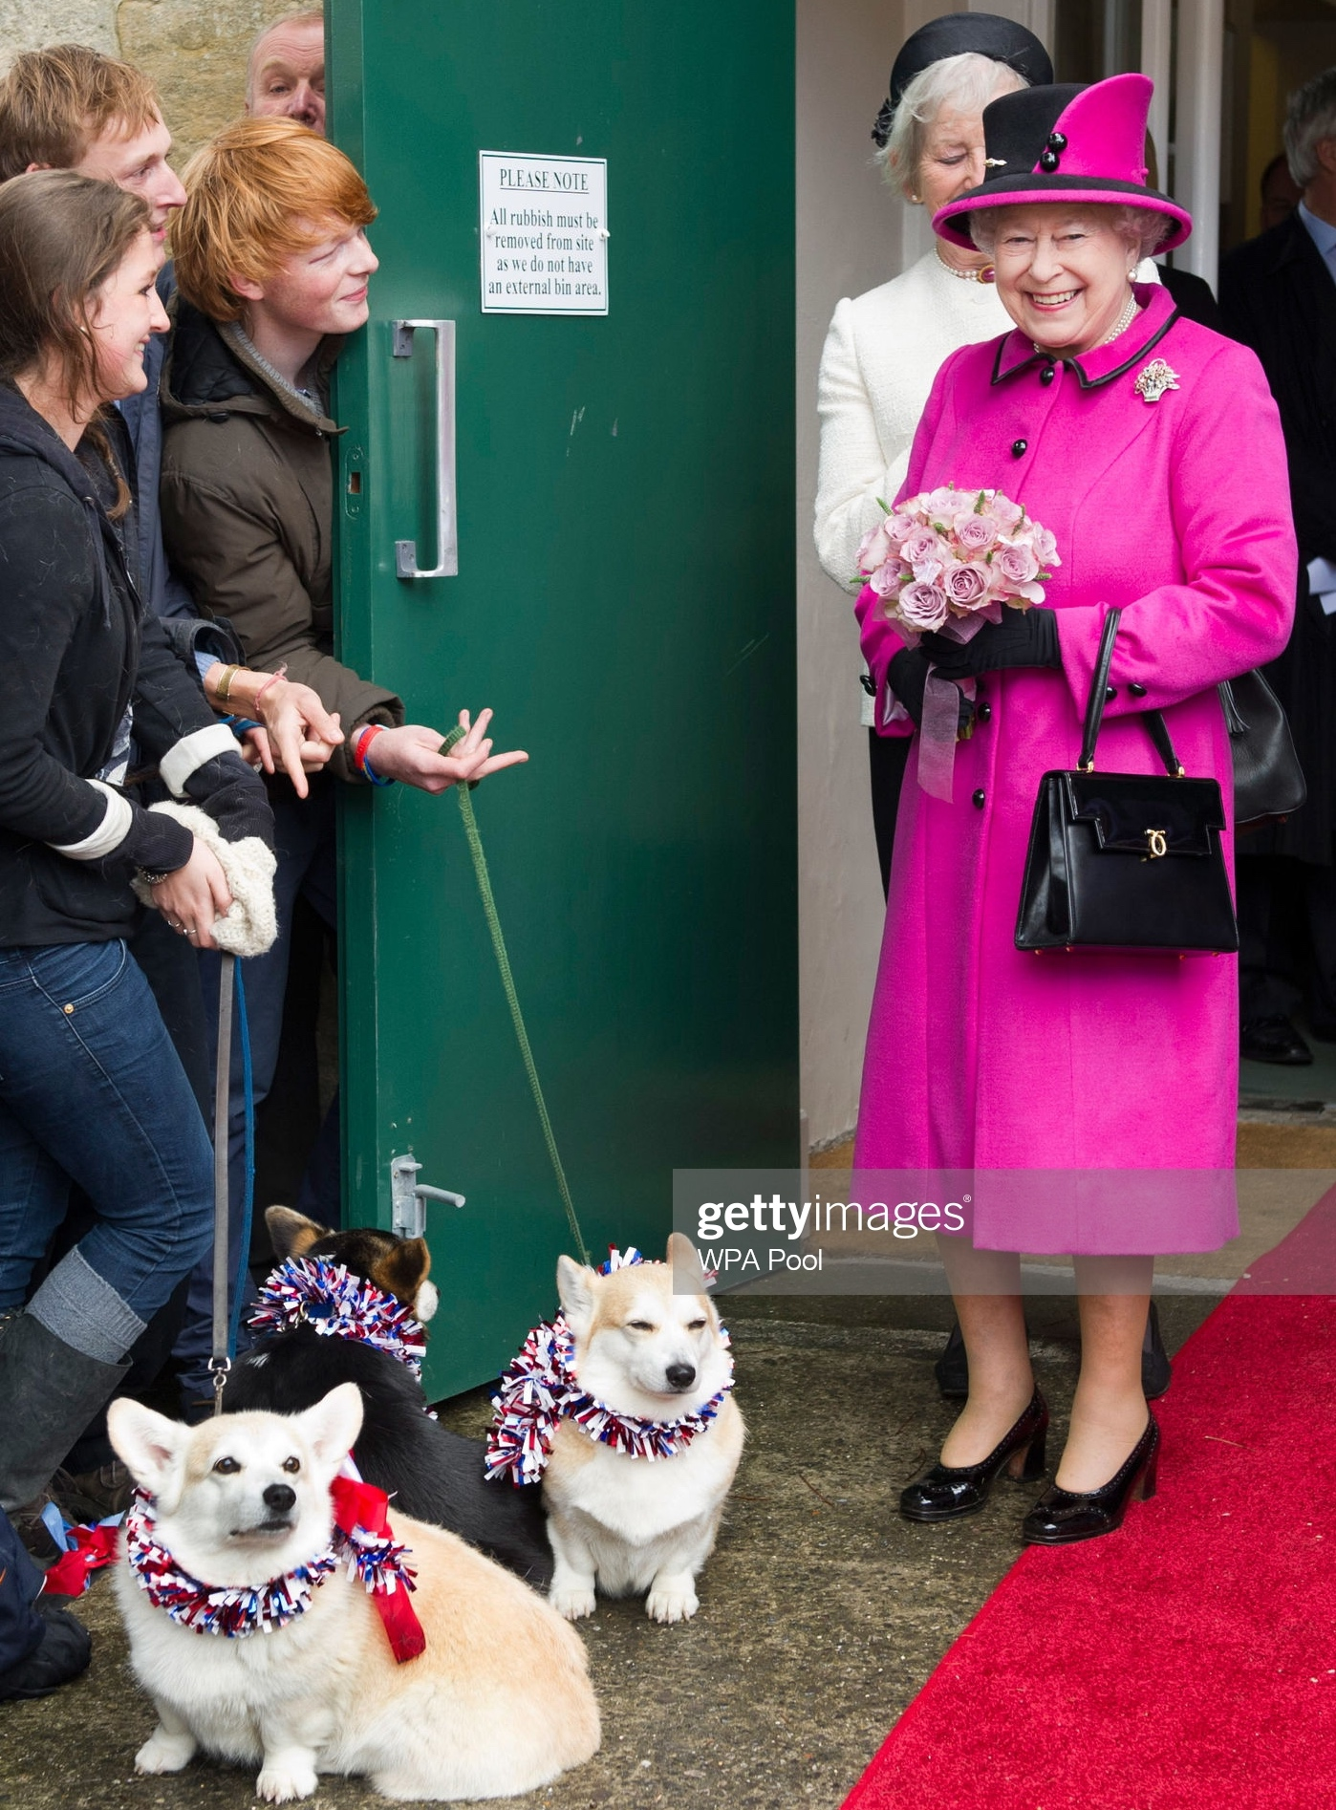
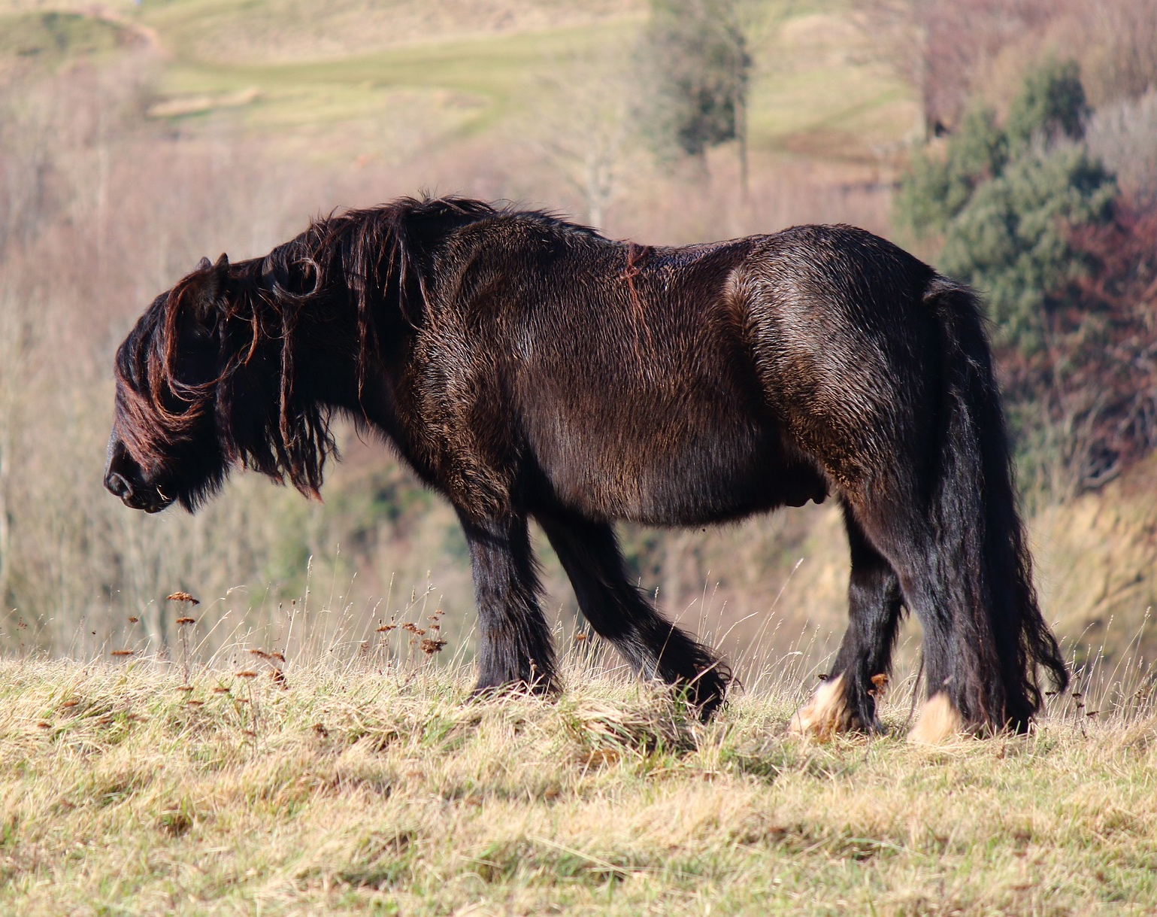
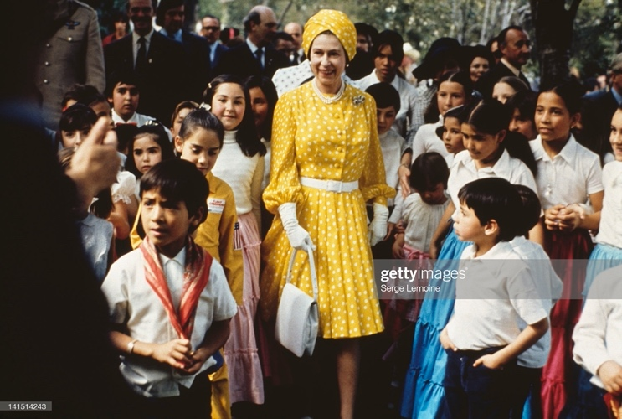
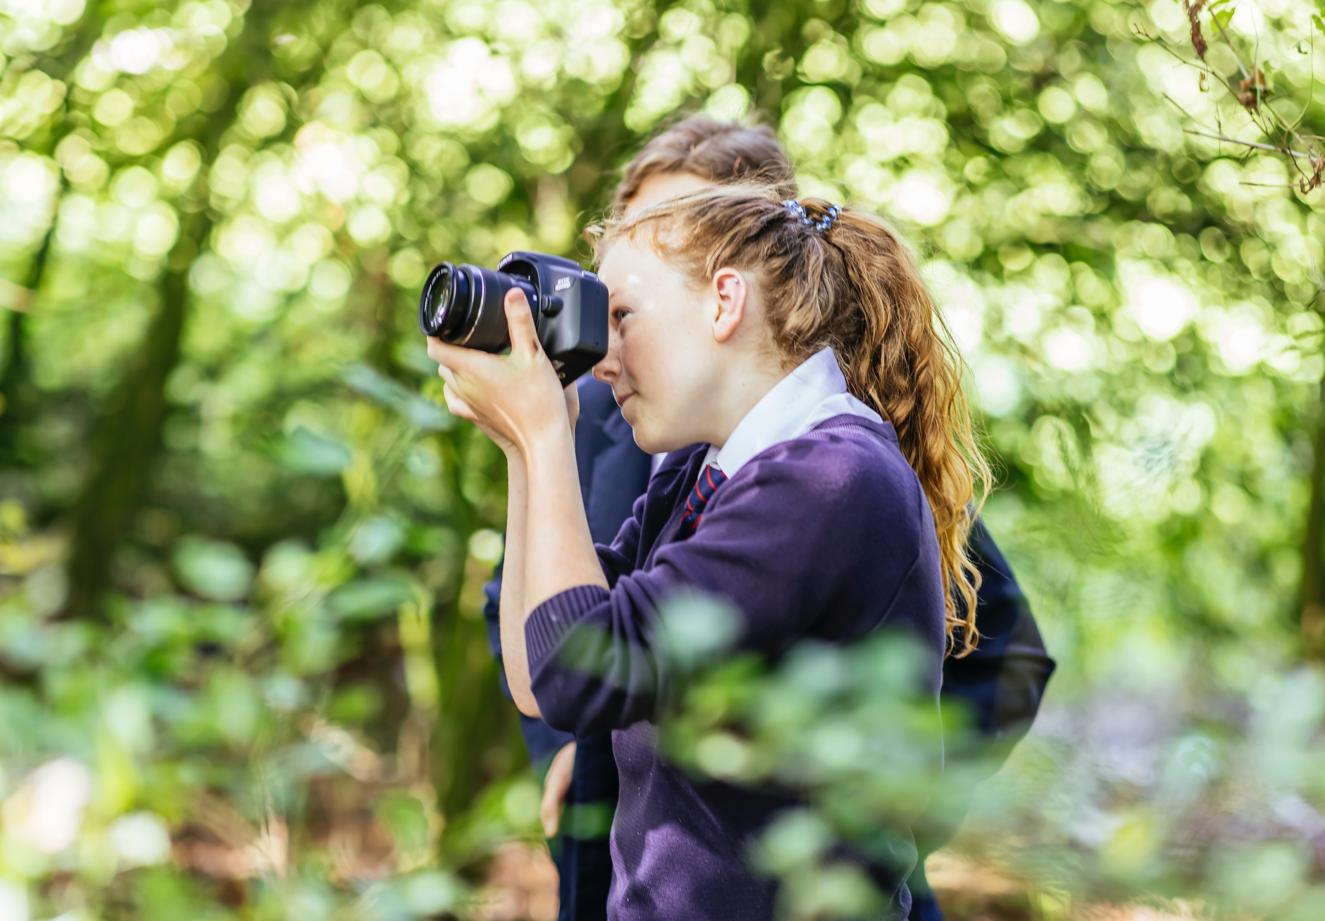
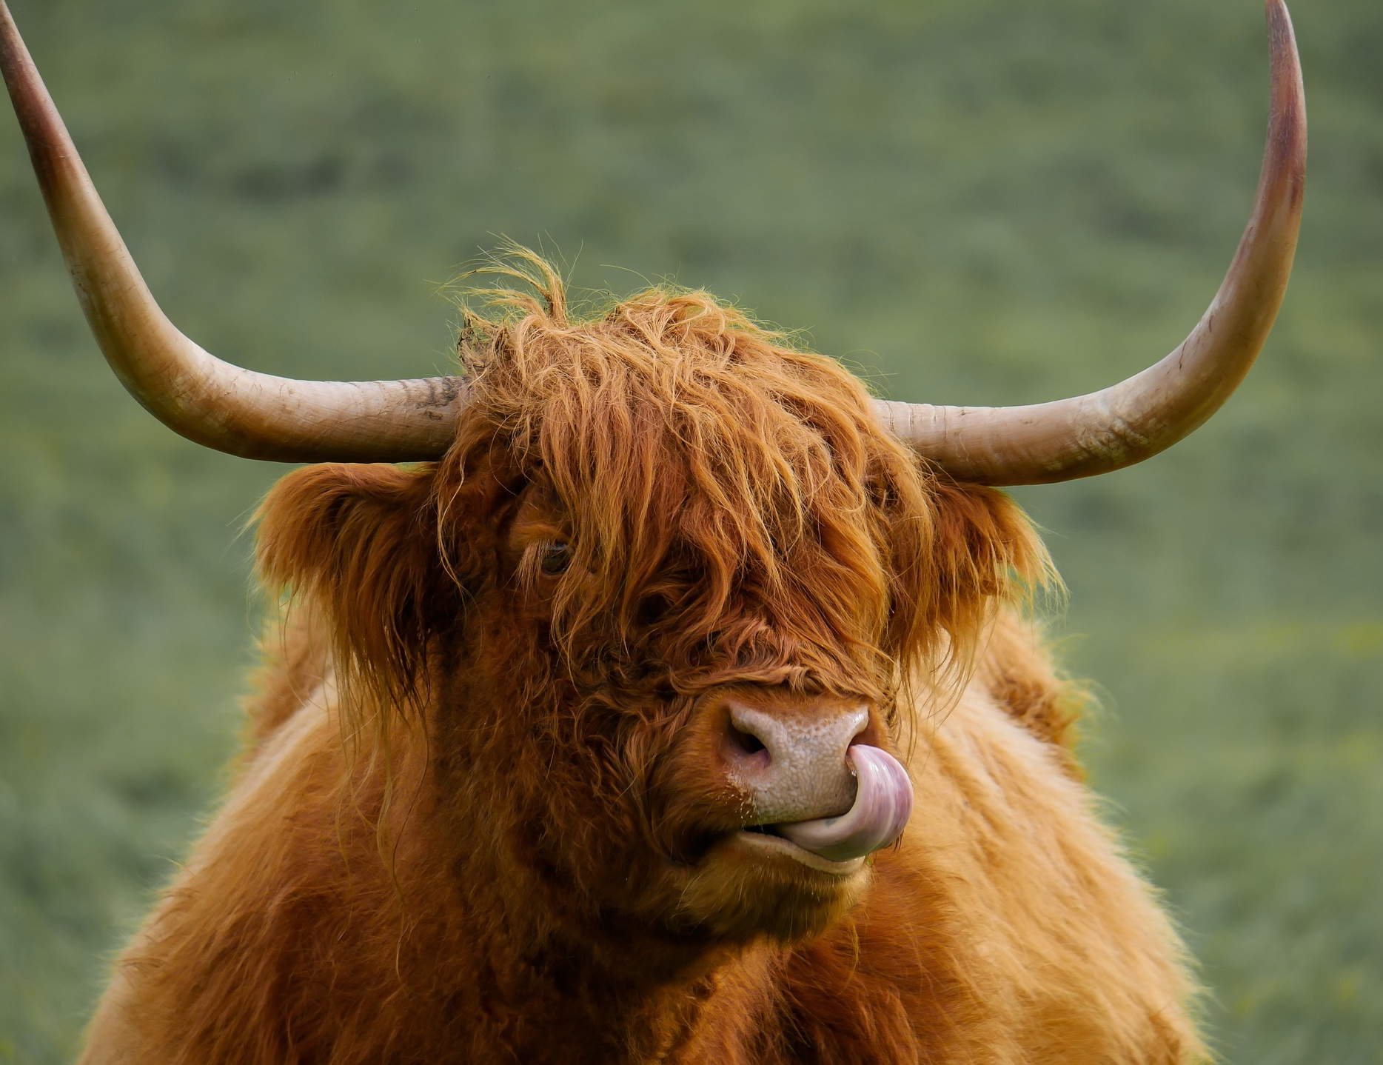
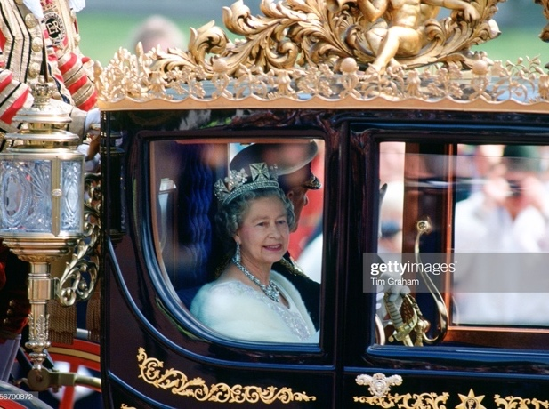
Inspiration
Every picture tells a story
When considering an image you wish to use, think about how others may see it. Is it getting across what you are trying to say or could it be misinterpreted?
Look at the photos opposite, what does each one say?
Photo: Tom Martin
11 | Ideas Foundation brief

Slide 12
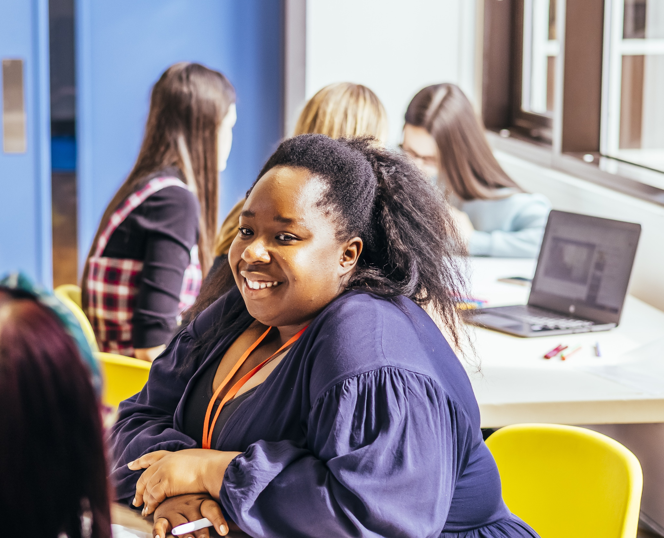
Inspiration
Thank you day
Sunday 5 June is also Thank You Day. Perhaps you could use this as your inspiration, taking the opportunity to create a piece to thank someone in your community for their kindness.
https://thankyouday.org.uk/
12 | Ideas Foundation brief

Slide 13
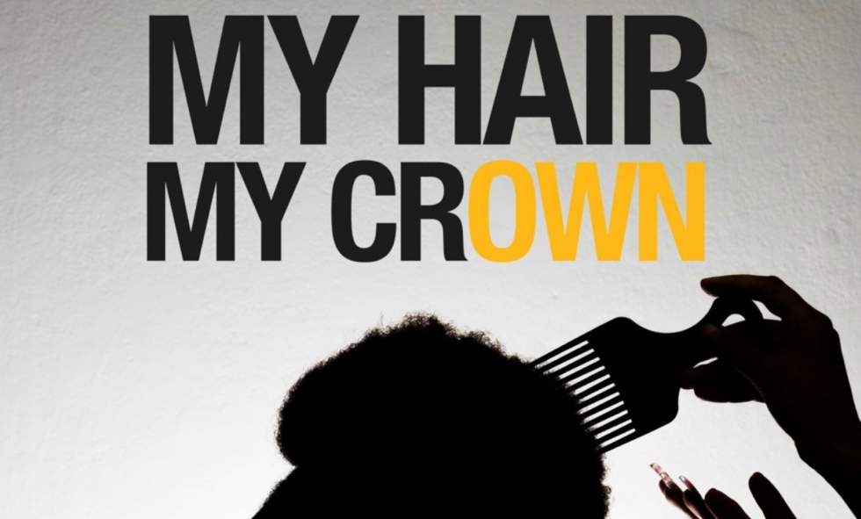
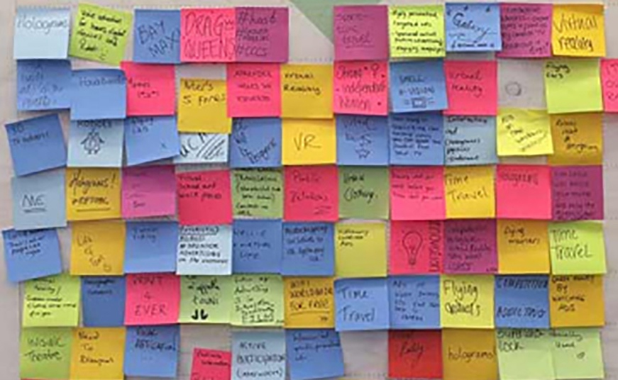
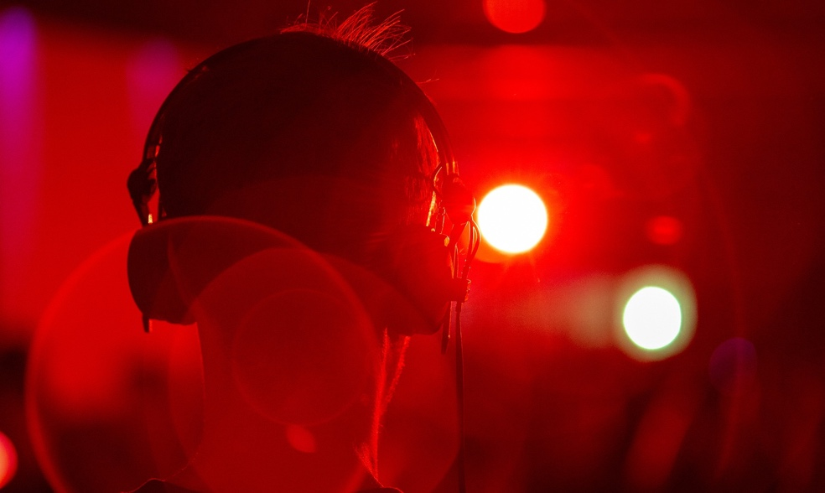
What we would like you to create
A celebration of community, kindness and commonwealth
Imagery
Think about the medium you use to achieve a positive result, it could be a single photographic image, a short moving image or montage of photographs. It should have eyecatching vibrancy and look amazing at high resolution. Consider your image size to ensure the most impact on the viewer.
Words
Your image could be based on words that you feel celebrate this occasion or you could write a poem. You could consider The Queen’s passion for wildlife or cultures. You will need to follow a cinquain structure and have no more than 5 lines.
Audio
Your creation could be an audio presentation, no longer than 5 minutes long. Think about the sounds around your community.
13 | Ideas Foundation brief

Slide 14
What we would like you to create
A celebration of community, kindness and commonwealth
Imagery
Create an image to celebrate the Commonwealth of Kindness. Think about the medium you use to achieve a positive result, it could be a single photographic image, a short moving image or montage of photographs. It should have eyecatching vibrancy and look amazing at high resolution. Consider your image size to ensure the most impact on the viewer.
sample single page
14 | Ideas Foundation brief

Slide 15
What we would like you to create
1.
Your Wow Creation!
Create a celebratory image, poem or audio that may used across various platforms. Your idea should convey a community, kindness and inclusivity. Think about the medium you use to see the richness in our diversity.
It is important you ensure that any materials used are as sustainable and eco-friendly as possible. If you are sourcing an image rather than creating one make sure that you have permission for use.
15 | Ideas Foundation brief

Slide 16
What we would like you to create
2.
Your story
We would like to know the story behind your chosen image, poem or audio. Whether it is how The Queen has influenced your school and community or how her values of diversity, sustainability and kindness are important to you personally.
This should be no more than 50 words and should include your name, school/college, and a little about yourself and your community.
16 | Ideas Foundation brief

Slide 17
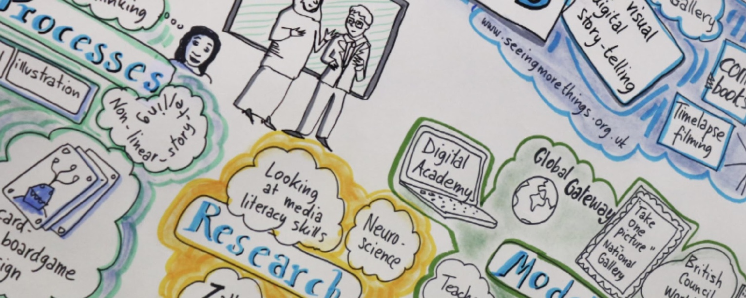
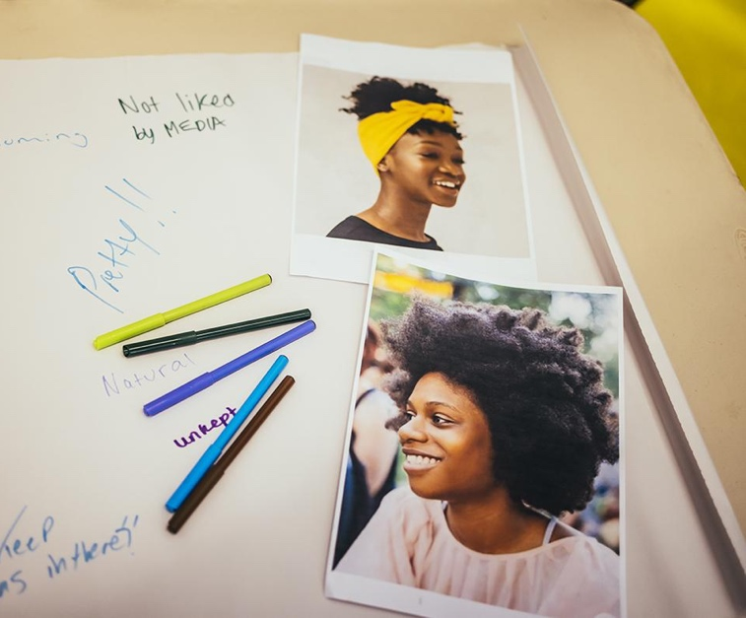
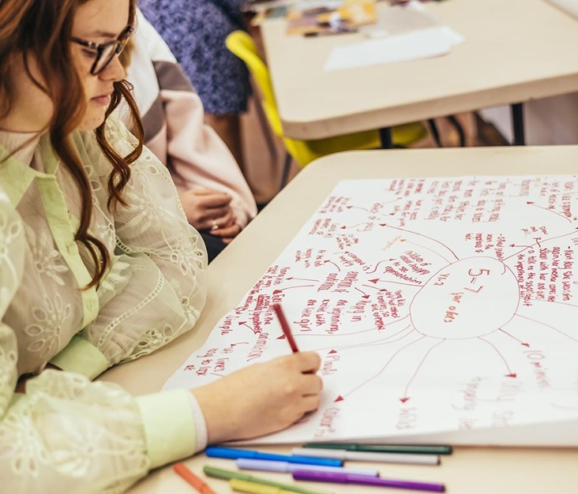
Things to consider
Graphic and visual style
Begin by doing full research around the theme you wish to focus on. Think about the content of your piece, and the key message you wish it to portray. Use word banks and mindmaps to help you to think about a range of ideas. Don’t dismiss any idea at this stage. Think about the brief with different hats – factual, emotional, positive, critical etc.
Create moodboards to help you think about mood, colours and audience. Think about the use of colour and imagery to ensure your image fulfils the brief of a visual piece that is in keeping with the Platinum Jubilee Pageant.
All images need to be free to use and should either be created by you or royalty free for use in a commercial bill board setting.
17 | Ideas Foundation brief

Slide 18
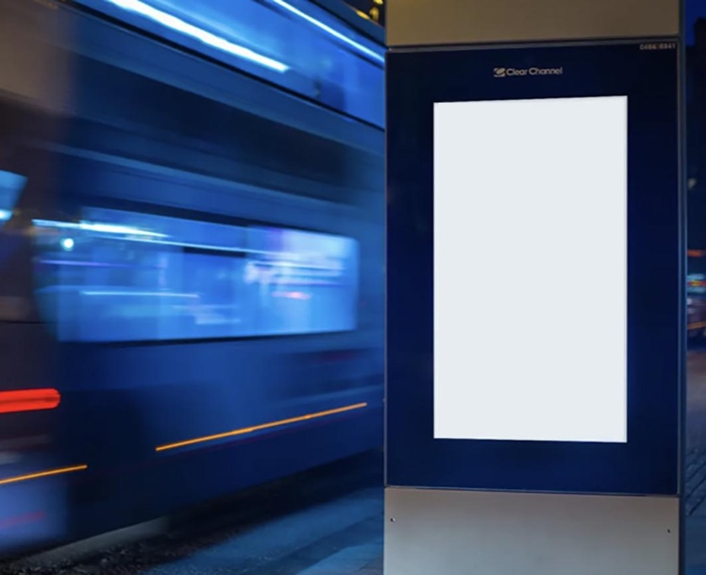
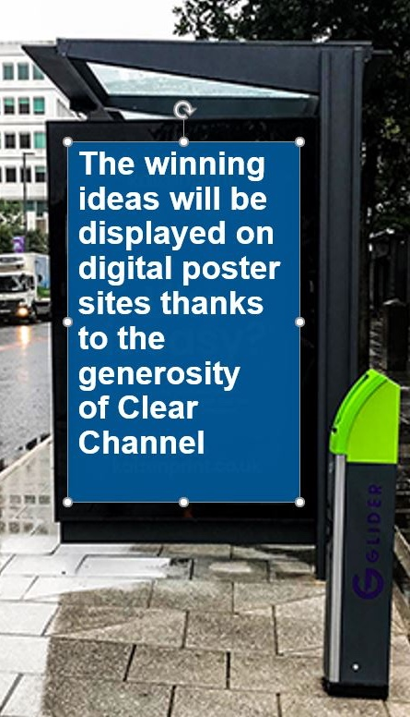
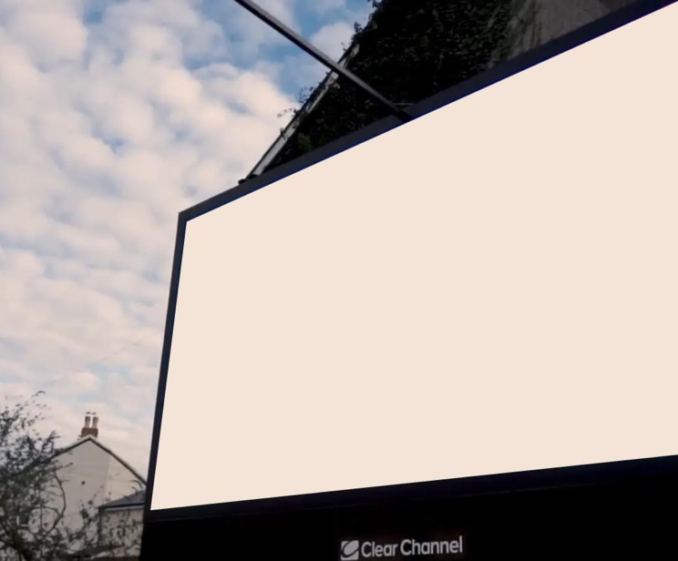
Things to consider
Your audience
Your audience is likely to be people of a variety of ages in your community. Some may be older and have seen the changes in community that have happened during The Queen’s reign.
Depending on your location, some people may not speak English as their first language.
Others may be parents with small children.
Or it could be school students on their way to and from school.
It may also be seen by motorists and cyclists so your image should not be distracting or look like a traffic sign.
18 | Ideas Foundation brief

Slide 19
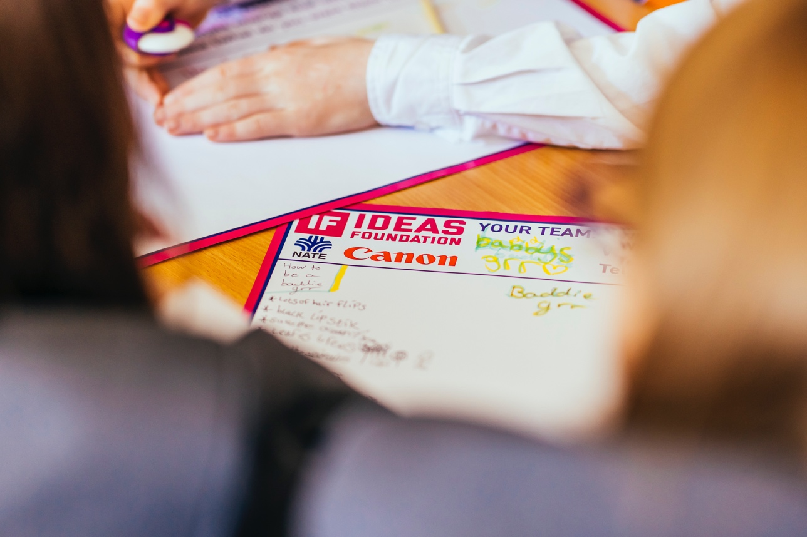
Target Audience
Checklist
When developing your ideas, it is worth bearing in mind the following questions:
Will it appeal to your target audience?
Will it stand out?
Does it clearly convey your key message?
Will it make people want to find out more?
Is it positive and celebratory and meet the brief?
Photo: Tom Martin
19 | Ideas Foundation brief

Slide 20
Specifications
Visual specifications:
Digital Boards
1080px by 1920px in size
Resolution: 150dpi
Format: JPG in
RGB colourspace
Portrait
End line details, as shown below, must
be included.
Social Media
Refer to each site for specifications
Resolution: 72 pixels per inch
Format: JPG/PNG/BMP/MOV/MP4
in RGB colourspace
Portrait or landscape
End line details, as shown below, must
be included.
6 Sheet Poster
Size: 1.2m by 1.8m (including 20cm end line)
Resolution: 72 pixels per inch
Format: Photoshop CMYK eps/tiff/psd/jpg or Illustrator eps or Acrobat Pdf
Landscape
End line details, as shown below, must
be included.
20 | Ideas Foundation brief

Slide 21
Glossary of terms
Dpi
Stands for Dots per Inch and is sued to indicate the resolution of an image for screen and print. 300dpi is required for print whilst 72/96dpi is required for screen.
Commonwealth
The Commonwealth is an association of 54 independent countries who have agreed to share goals for democracy, development and peace.
Pdf
PDF stands for Portable Document Format and is the file format for capturing and sending documents in their intended format.
Platinum Jubilee Pageant
The Pageant will offer the excitement and spectacle of and international parade and carnival to celebrate the 70 year reign of Her Majesty The Queen. www.platinumpageant.com
Six Sheet
A 6 sheet poster is a form of outdoor advertising consisting of large format poster typically found around bus shelters.
Royal Family
Follow the link to find out more about the roles of members of the Royal Family. www.royaluk
Cinquain
A form of syllabic poetry using a 5 line structure: 1st line: 2 syllables, 2nd line: 4 syllables, 3rd line: 6 syllables, 4th line: 8 syllables, 5th line 2 syllables.
Moodboards
A visual presentation or collage comprising of images, text or object samples collated into a composition to portray an idea or emotion about a subject.
RGB /CMYK
RGB refers to the red, green and blue colour values used online. CMYK is the cyan, magenta, yellow and black breakdown of colours used for print.
21 | Ideas Foundation brief

Slide 22
Any questions?
Contact: ideas@ideasfoundation.org.uk

