Slide 1
Creative Communication
Your task: help Specsavers persuade young people to get their eyes tested regularly.

Slide 2
Creative communication: KS3 and GCSE English
What’s this all about in English?
It’s about developing:
skills in reading and writing non-fiction texts
communication matched to audience and purpose
GCSE skills in interpretation, analysis, evaluation
speaking and listening, reading and writing as processes.
What else is this about?
Life-skills:
collaboration and creativity.
links between verbal and visual literacy.
English beyond the school and classroom.

Slide 3
To start ...
Form a team with 1-2 friends. This will be your advertising agency.
Decide how you will communicate with each other, using a platform of your choice, such as WhatsApp, Discord or Instagram.
Give your agency a name. It might be from your own names, or a place, or anything that inspires you.
Watch these videos together, which introduce you to how an advertising agency works, and how a creative team that come up with ideas works: https://www.youtube.com/watch?v=yb-odF3szpU https://www.youtube.com/watch?v=tn6EKVbGcPI
Now read on and find out about your task, involving the company Specsavers.

Slide 4
Who are Specsavers?
Specsavers is one of the most famous and recognisable brands on the High Street, and has more than 1500 stores all around the world.
They aim to offer a wide range of stylish, fashionable glasses at prices affordable for everyone.
They want to be as trustworthy as a local independent optician, but because they buy a lot of glasses they can pass the savings on to the customer.
Most people have heard of the slogan “Should’ve gone to Specsavers”, which was introduced in 2003, so the brand is well-known.

Slide 5
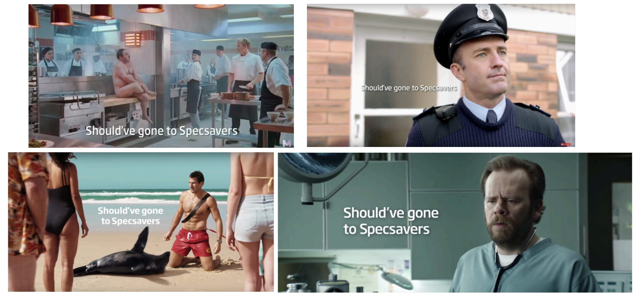
Who are Specsavers?
Their adverts are well known for being funny - they take looking after your eyesight seriously, but they don’t take themselves too seriously.

Slide 6
The company has a long history of giving back to and working with local communities, such as:
raising more than £1.6 million a year for charities
being an official partner for Red Nose Day
publishing a national eye health report with the Royal National Institute for the Blind

Slide 7
Specsavers and schools
Good vision is vital during school years. If a student can’t see the board properly, or the words are blurred when they try to read, they might find it difficult to perform to their full potential.
Specsavers work to raise awareness of children’s eye health and remind parents of the importance of regular eye tests for their children. Research commissioned jointly with the Royal National Institute of Blind People has revealed that almost two in five parents (38%) say their child has not had one in the past two years.
Specsavers have also has teamed up with a company called Thomson Screening to deliver free vision-screening software to every primary and secondary school across the country.

Slide 8
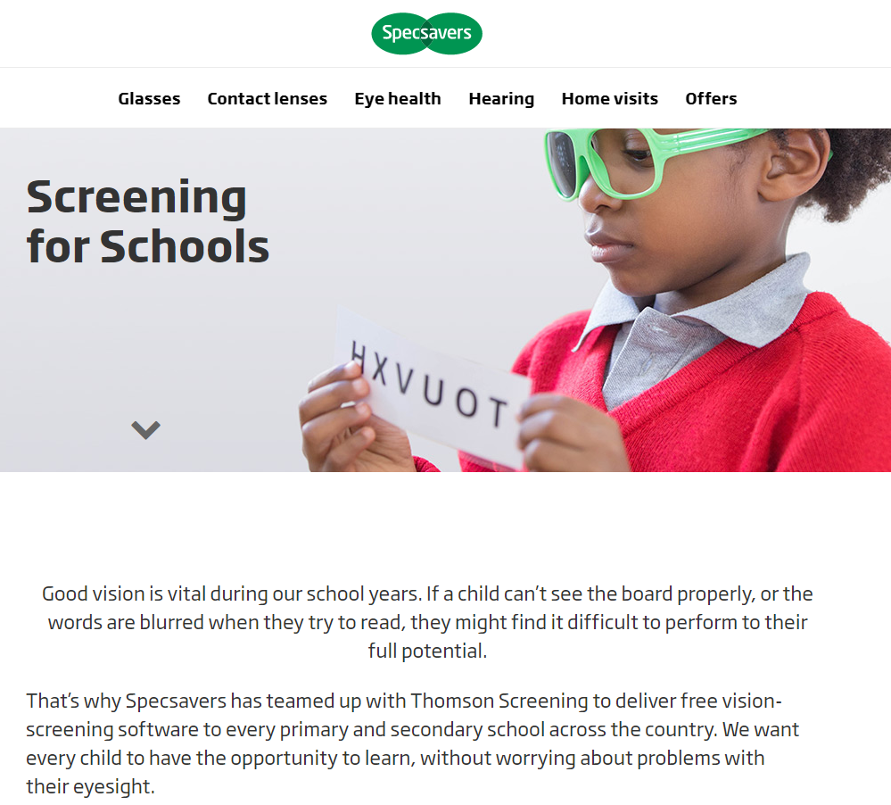
This is what Specsavers have written on their website to tell people about their work in schools:
from https://www.specsavers.co.uk/screeningforschools

Slide 9
Your task ...
Teenage years are the prime time for the development of sight issues, so many children will start to need prescription eyewear in their teens.
It’s important to encourage teenagers to get into the habit of having regular eye examinations, even if they don’t think there’s anything wrong with their vision.
Create a piece of communication that helps people like you understand why taking a sight test every two years is important for learning, and that Specsavers offer free eye tests for under 16s.
People are exposed to huge amounts of advertising and often switch off. So your work needs to grab their attention and keep it. Boring your audience means losing your audience.

Slide 10
Your task … part 1
Do some research on the SpecSavers brand, products and image - take a look at the adverts and other links on the last page of this briefing.
Try out several ideas before choosing the best one.
Present your proposal using a few words, plus images or video in one of the following formats:
a poster (as on a billboard, bus or an advert in a magazine)
an Instagram post or story
a TikTok or other ‘looping video’ format
You don’t need any fancy equipment. We’re interested in your ideas as well as what the proposal actually looks like
Simply email your image/post/video to your teacher along with the written explanation of why you chose what you did (see next slide).

Slide 11
Your task … part 2
This is an English project.
When you have produced your post/poster/story/video, we want to see your journey from start to finish. The written part of your project should give details of:
how you managed the task, including reasons for adopting or rejecting ideas
how you chose your target audience(s), and where to place your work to reach it/them
your reasons for choosing words and phrases to impact on your readers/viewers
your reasons for choosing design features such as fonts, images, colours and straplines.
This will help us to see the quality of your creative process as well as the quality of your created product.

Slide 12
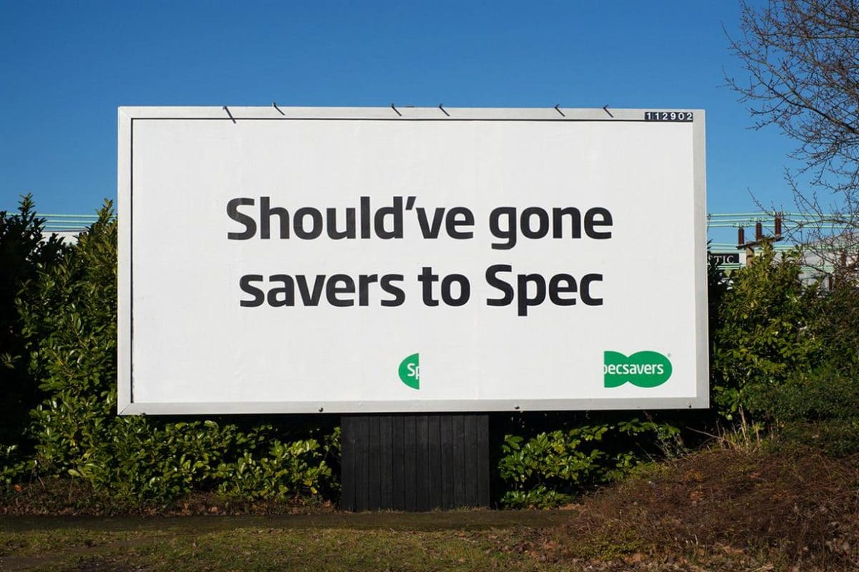
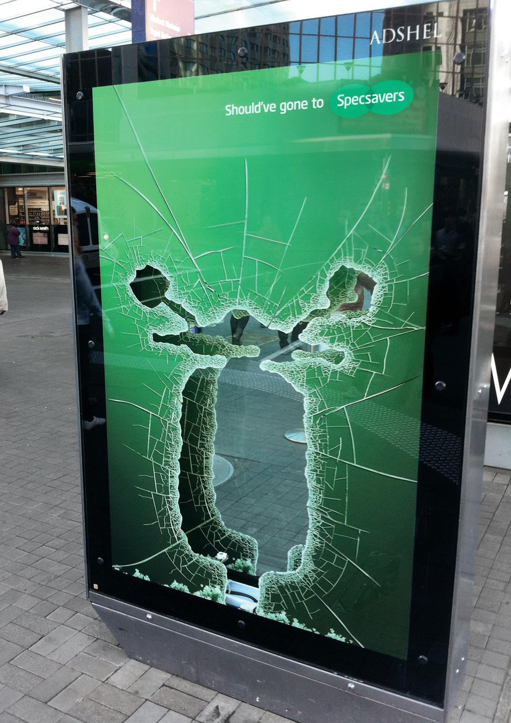
Additional inspiration
Specsavers have an extensive YouTube channel with all of the their TV ads and much more: https://www.youtube.com/playlist?list=PLrIO2ysCa6RlmDYWPGYtXbO_1XuEXn4_Y
Specsavers posts on Instagram - mainly used to show people loving their glasses: https://www.instagram.com/specsavers/
Specsavers don’t officially use TikTok, but their famous catchphrase ‘ Should have gone to Specsavers’ is a popular hashtag: https://www.tiktok.com/tag/shouldhavegonetospecsavers

Slide 13
Extension: stretch and challenge
Go creative! Go solo!
Invent your own product or service to raise teenagers’ health and welfare awareness.
Produce an advertising campaign across several media platforms.
Add your account of how you chose audience, placement, words & images.
You could try:
a new eating regime
a fitness routine
a self-assessment questionnaire

